Slide 1
Root Cause Mapping Working Group (RCM WG)
May 22, 2024
Alec Summers, Chair
Erin Alexander, Co-Chair

Slide 2
Agenda (1:00–1:50 PM EDT)
This meeting is being recorded
Welcome!
Main Items:
New feedback on CWE RCM guidance/labeling
2024 Top 25 overview and discussion
Agenda Planning
Adjourn

Slide 3

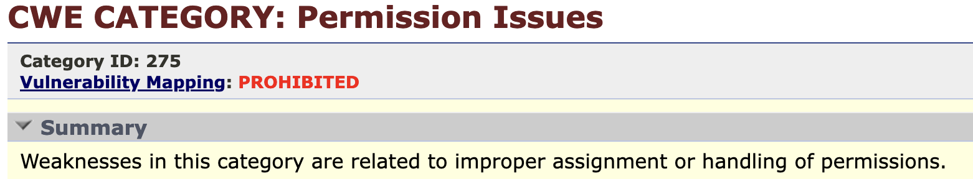
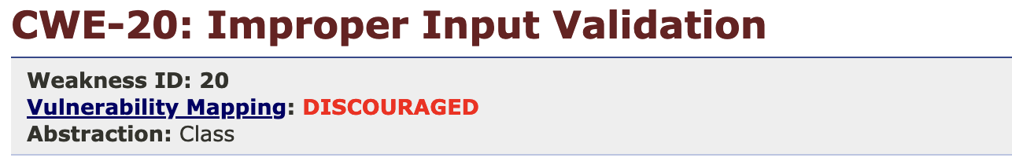
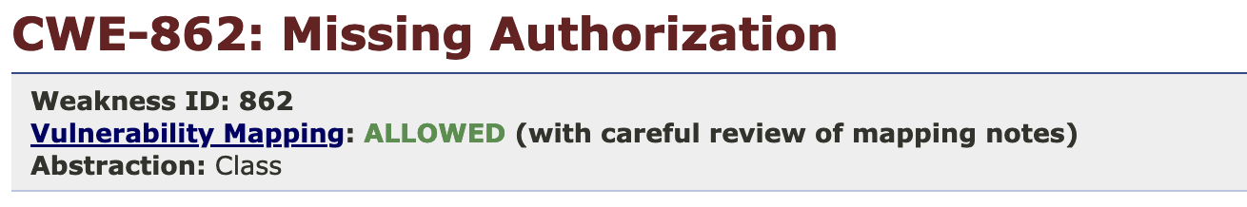
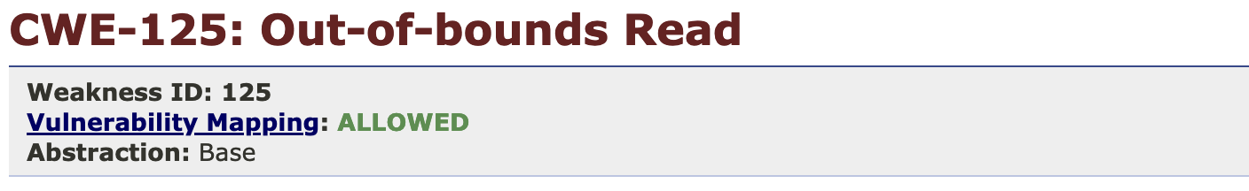
Vulnerability Mapping Labels
Actionable

Slide 4
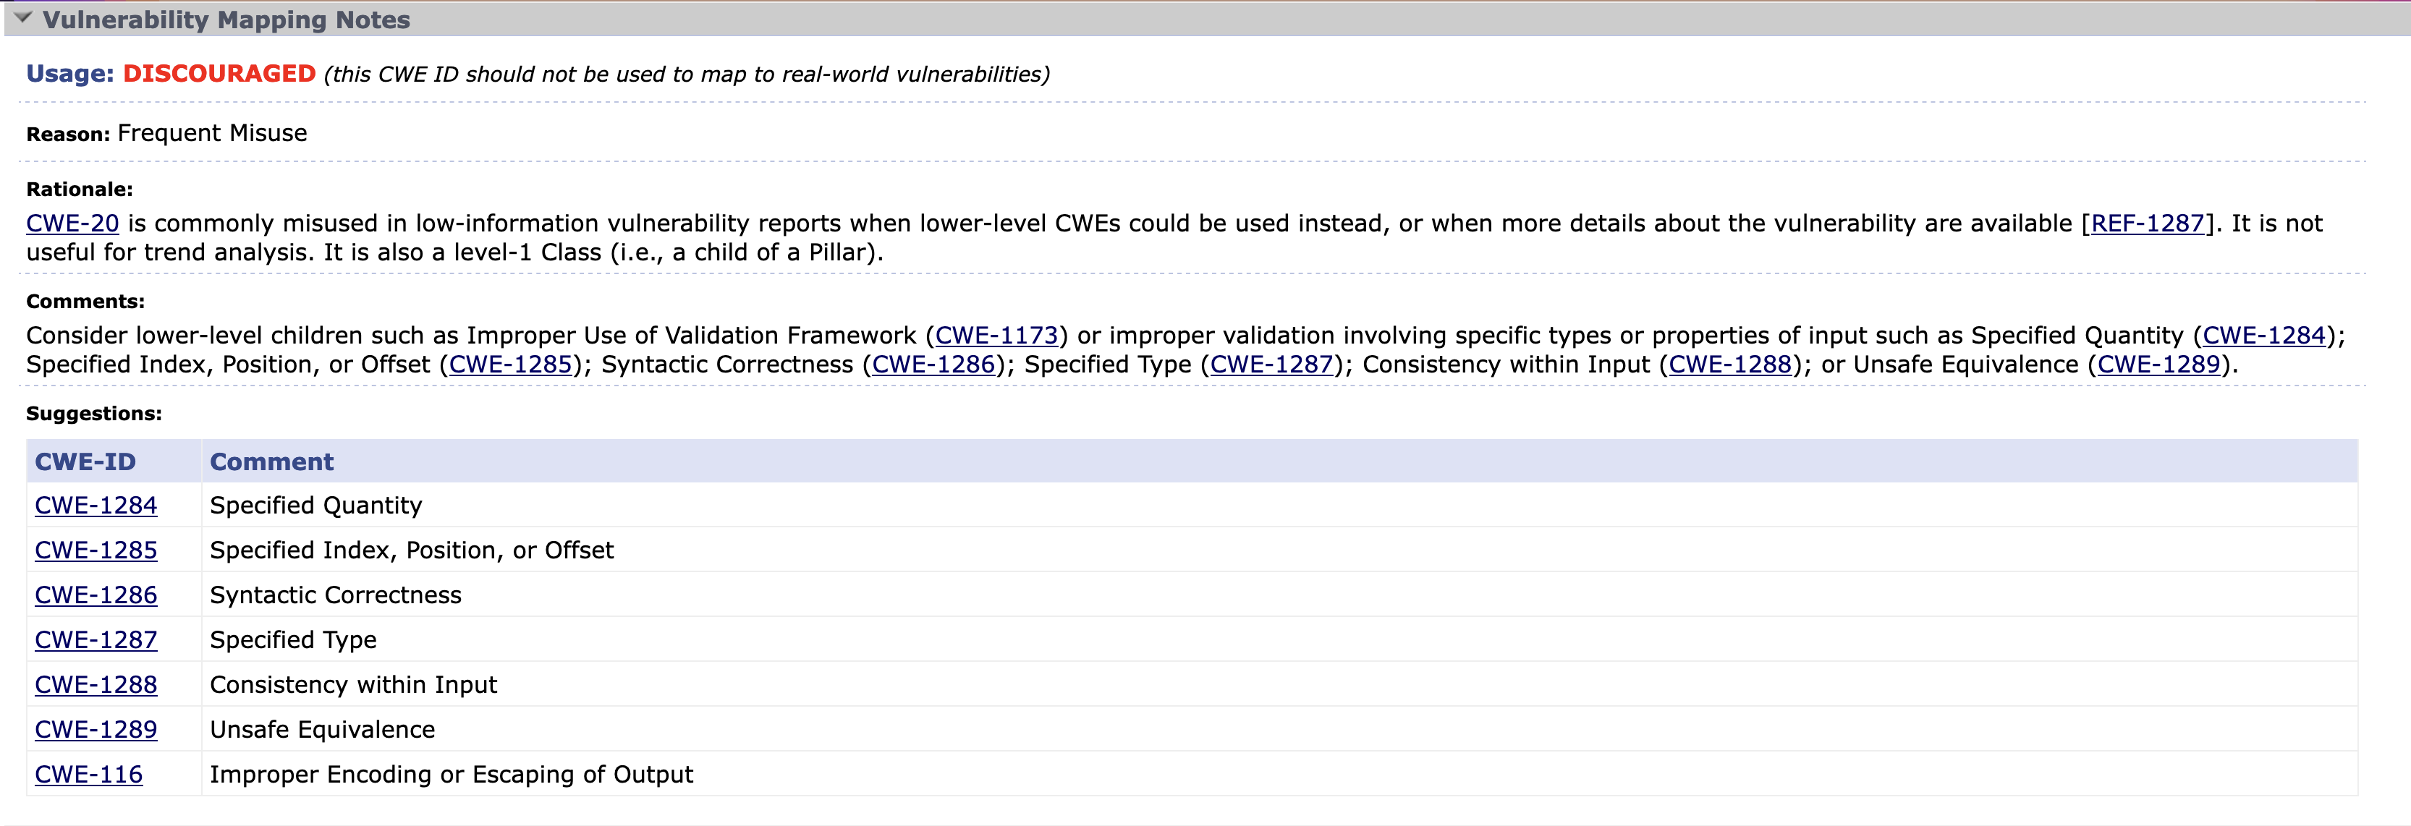
Mapping Notes
CWE 7.0 schema update added “Mapping_Notes” element
Contains support for details including Usage, Rationale, Comments, Reasons, and Suggestions fields for vulnerability mapping efforts. E.g., CWE-20:

Slide 5


Guidance
https://cwe.mitre.org/documents/cwe_usage/guidance.html

Slide 6
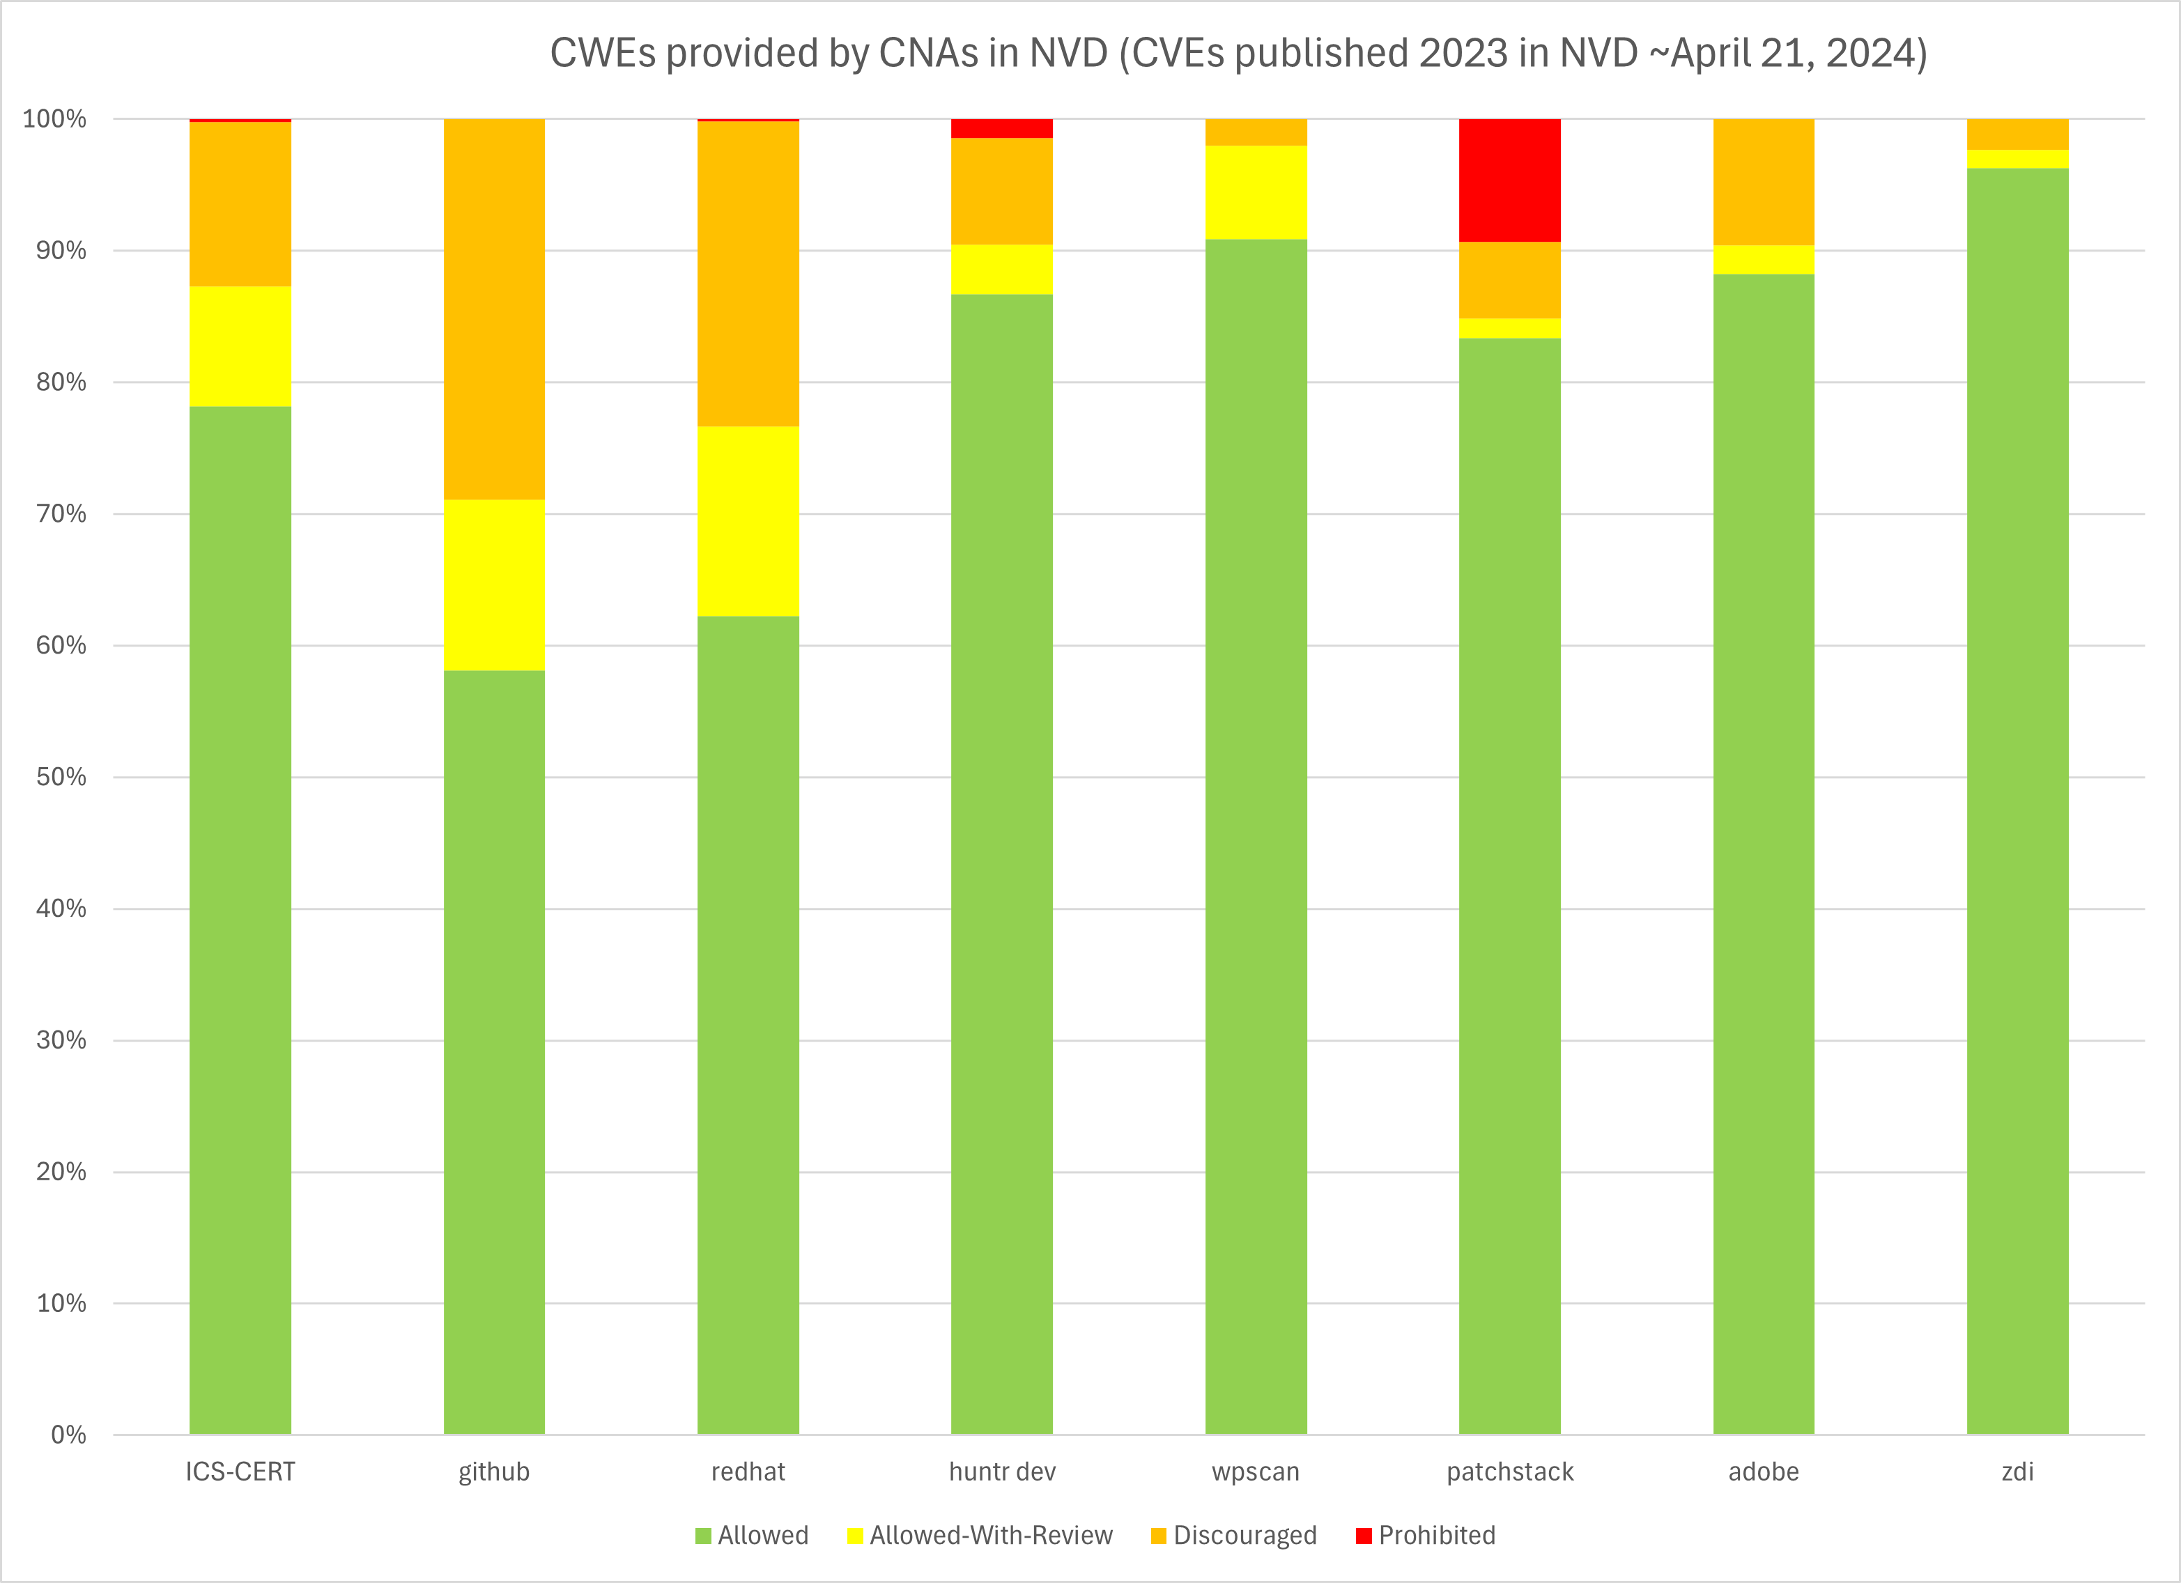
A Look into Current Activity
CNA | TotMaps | TotUniq | Allowed | Allowed-w/Review | Discouraged | Prohibited
ICS-CERT | 472 | 113 | 369 | 43 | 59 | 1
GitHub | 1259 | 172 | 732 | 163 | 364
Red Hat | 596 | 121 | 371 | 86 | 138 | 1
Huntr dev | 851 | 108 | 738 | 32 | 69 | 12
wpscan | 936 | 31 | 851 | 66 | 19
patchstack | 343 | 17 | 286 | 5 | 20 | 32
adobe | 460 | 27 | 406 | 10 | 44
zdi | 298 | 32 | 287 | 4 | 7

Slide 7
Open Discussion & Feedback
Mapping Labels
Mapping Notes
What challenges are you facing right now?

Slide 8
2024 Top 25

Slide 9
Top 25 Overview
Since 2019, annual publication analyzing CVE Records’ root cause CWEs over previous two years, and ranking them according to prevalence and severity
Prevalence is measured by the number of times the weakness is the root cause of a CVE Record in the dataset
Severity is measured by the average CVSS score for the CVE Records resulting from an individual weakness
The CWE team takes effort to maximize the dataset’s accuracy in terms of root cause mapping (RCM) between CVE Records and CWE entries

Slide 10
Top 25 Data Quality / Accuracy
CWE team’s “remapping” effort aims to identify and address inaccurate / imprecise CWE mappings in the dataset
Validating the entire mapping dataset is implausible. To help establish a baseline:
In 2023, the team identified 7,466 CVE Records for manual verification based on automated keyword search matching results that indicated likely errors able to be resolved before publication, and mappings to high-level CWE Classes
5,347 (71.6%) CVE Records were re-mapped accurately to CWEs
Percentage of inaccurate mappings outside of the manually reviewed subset is unknown
2023
Top 25
43,996 CVE Records

Slide 11

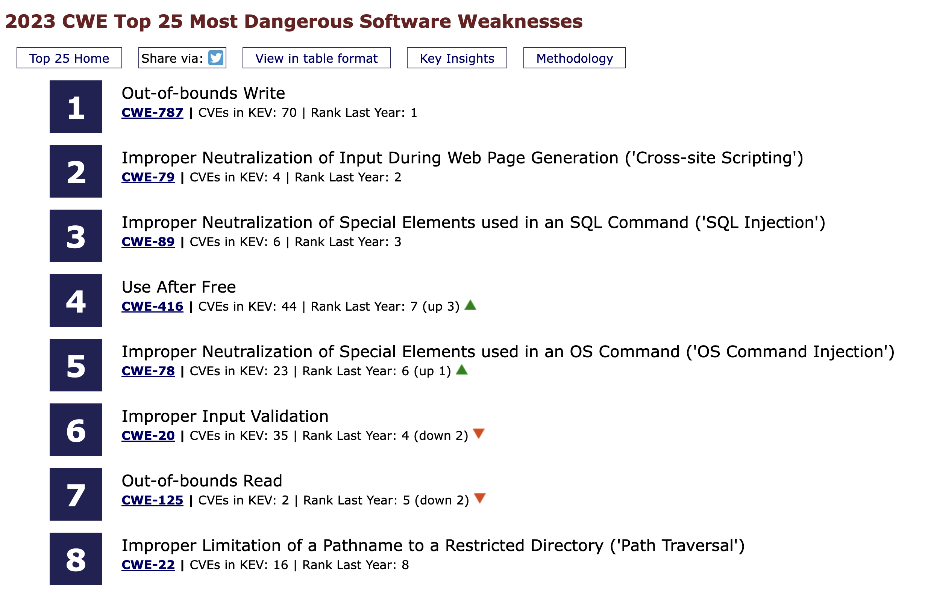
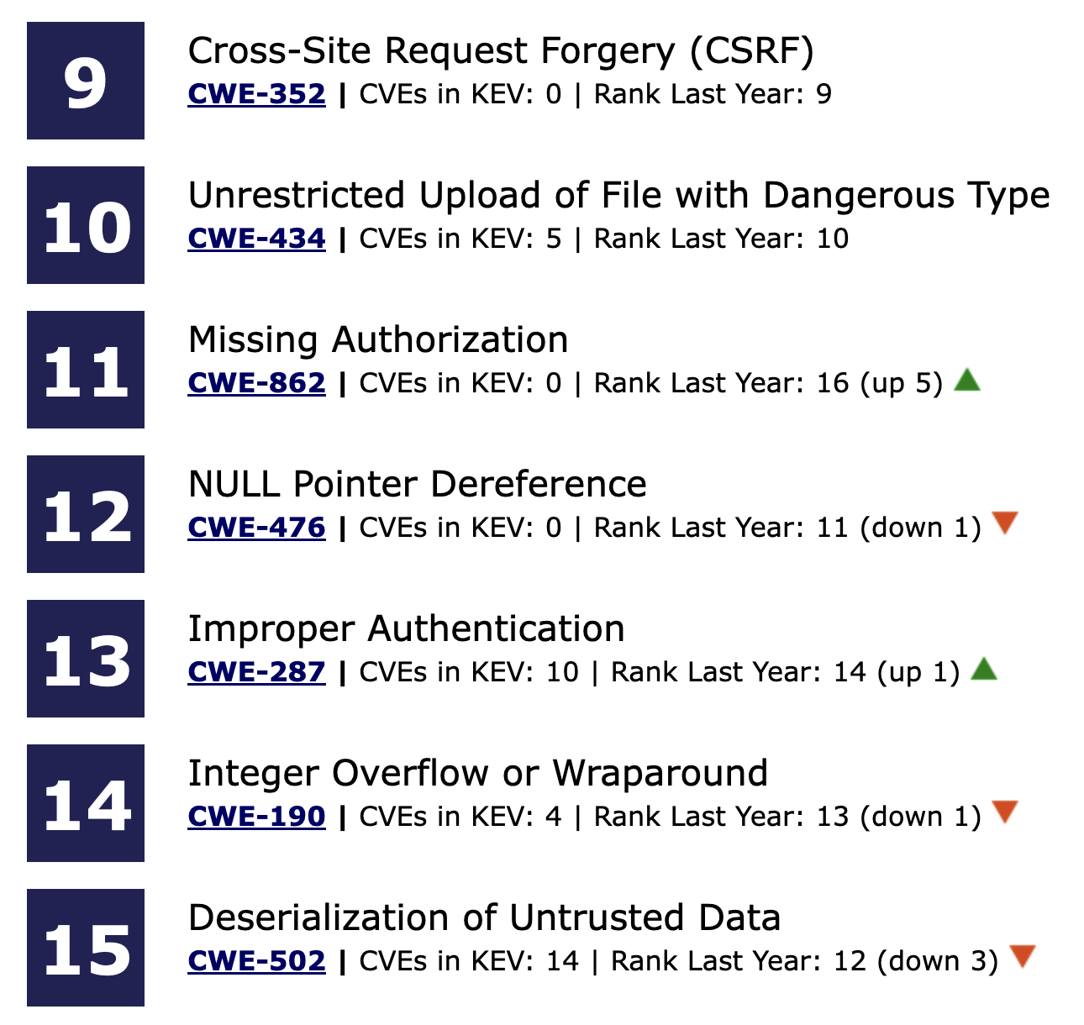
2023 CWE Top 25
← Click this icon in the top right corner of any CWE page to be taken to Top 25 info
etc.

Slide 12
2024 CWE Top 25
Publication likely Late Sept / Early Oct 2024
We plan to leverage the community this year in maximizing data quality in calculating the Top 25
In line with CVE Program goal of federating CVE Record data enrichment
Planning underway, may look like:
Asking CNAs and community members to help (e.g., review mappings, suggest changes, etc.)
Thoughts?

Slide 13
Agenda Planning

Slide 14
Agenda Planning
For next time…
Mapping examples – individual challenges people are facing?
Working through case study examples (e.g., new vuls, old vuls)
Volunteers for next time?
Feed CWE Website guidance page / point to new GitHub repo of examples
Capability building / testing
Exploring existing capabilities for RCM support (e.g., Merysol CWE Advisor Tool, others)
Other development opportunities

Slide 15
Housekeeping
Communications channels established
GitHub: https://github.com/Root-Cause-Mapping-Working-Group/RCM-WG
Meeting slides, draft one-pager & charter – please provide feedback
Slack Channel:
For access, contact asummers@mitre.org or erin.alexander@cisa.dhs.gov
Please continue to network about this effort
Happy to onboard new members

Slide 16
Adjourn
Thank you!
asummers@mitre.org & erin.alexander@cisa.dhs.gov

